Slide 1
Using HPC in the Cloud
Microsoft Research
Windows Azure for Research Training

Slide 2
Using HPC in the Cloud
Learning objectives – what you will learn:
Microsoft's High Performance Computing (HPC) distributed computing Server
A design pattern for scaling parameter sweep/map reduce for scientific analysis using standard tool with Windows HPC
Examples of when this is useful for research scientists

Slide 3
Agenda
HPC
Microsoft HPC (High Performance Computing) distributed computing Server
Setting it up
MATLAB demo
R demo
Notes:
Slide Objectives:
Introduce the topics that will be covered in this session
VALUE PROP
Speaking Points:
Notes:

Slide 4
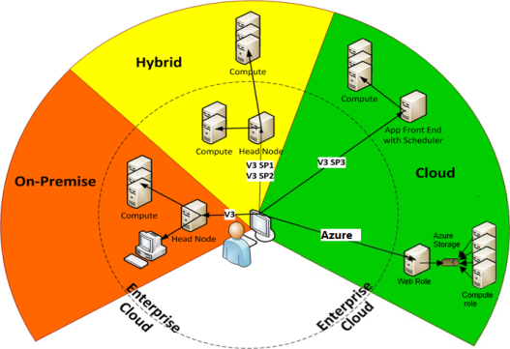
Microsoft HPC Scenarios
On-Premises
Your own servers inside your enterprise cloud.
Hybrid
Burst from enterprise to cloud.
Cloud
Head node in cloud or compute in cloud Or both.

Slide 5


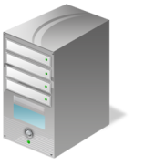

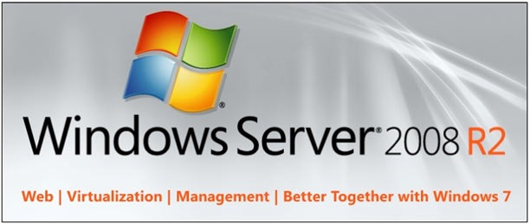
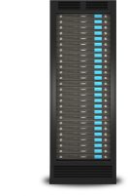




HPC Components (On Premises View)
On-premise
Desktop Compute Cloud via
Idle Win 7 Workstation Cores
HPC Edition
HPC Head Node
Desktop User
HPC Cluster
Broker Node(s)
Azure Compute Proxies
Azure Compute Instances

Slide 6


Examples of Azure HPC Workloads
Finance
Media
$
Pasta News
Life Sciences
Engineering
HPC Workloads by Sector
Notes:
Finance (CM+ Insurance)
Risk/Analytics
ESG/ALM
Media
Encode/Transcode
Analytics
Life science
Genomics
Cell profiling
Engineering/Universities
Some optimisation simulations

Slide 7

Embarrassingly Parallel Apps An illustration
Cluster of Compute Nodes
Compute Node
Compute Node
Compute Node
Application Logic
Application Logic
Application Logic
1. Submit work
2. (Optionally) Interact with application
Compute Node
Compute Node
Compute Node
Application Logic
Application Logic
Application Logic
3. Get results
Compute Node
Compute Node
Compute Node
Application Logic
Application Logic
Application Logic

Slide 8
Tightly Coupled App (MPI) An illustration
Cluster of Compute Nodes
Compute Node
Compute Node
Compute Node
Application Logic
Application Logic
Application Logic
1. Submit work
Compute Node
Compute Node
Compute Node
Application Logic
Application Logic
Application Logic
2. Get results
Compute Node
Compute Node
Compute Node
Application Logic
Application Logic
Application Logic
MPI = Message Passing Interface

Slide 9
IO Intensive Applications An illustration
Cluster of Compute Nodes
Compute Node
Compute Node
Compute Node
Application
Application
Application
1. Submit work
Compute Node
Compute Node
Compute Node
Application
Application
Application
2. Get results
Compute Node
Compute Node
Compute Node
Application
Application
Application

Slide 10
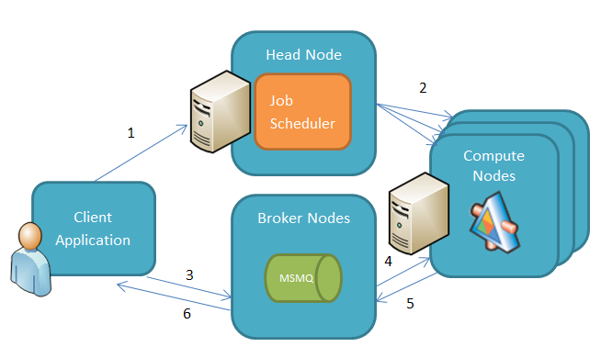
Using SOA with HPC Pack
SOA = Service-Oriented Architecture

Slide 11


Components in HPC SDK for Windows Azure
The full HPC Job Scheduler and Runtimes are available
Management of the compute resources will be handled by Windows Azure
Job submission API and portal
Job queue and priorities
Task activation and monitoring
Resource sharing policies
Azure Scheduler
Parametric Sweeps
Cluster SOA
MPI
LINQ to HPC
Excel
Distributed Runtimes
Cluster Deployment
Monitoring
Diagnostics
Reporting
System Administration

Slide 12
HPC Software Classifications
Low level API and executable launch
Low level network access uses NetworkDirect
Creates a cluster by assignment of communicators
The choice of HPC Software type depends on the workload of the expected tasks for the Cluster. Each has its areas of strength, from development simplicity to pure performance power.
Message Passing Interface
Service Oriented Architecture
Familiar use of WCF and SOA
SOA client can consume services directly or through HPC Scheduler
Soa Services
Command Line Interface
Can be written in any language hostable in Windows
Can be scheduled in a robust way
Parametric Sweep
Notes:
MS-MPI provides an mpiexec.exec which can be used to execute application nodes on the cluster and pass messages and collect results
NetworkDirect skips Winsock and TCP/IP stack so has a much faster completion time and uses less CPU cycles
MPI is used for inter-process communication and MS-MPI contains 160 APIs which allow messages to be sent and received from the processes which are part of the communicator

Slide 13
Creating a package
hpcpack create MyApp.zip MyApp

Slide 14
Uploading to blob storage
hpcpack upload MyApp.zip /nodetemplate:"Template" /relativepath:MyApp

Slide 15
Distributing and syncing package updates
clusrun /nodegroup:AzureWorkerNodes hpcsync

Slide 16
Send commands to cluster
clusrun /nodegroup:AzureWorkerNodes dir %CCP_PACKAGE_ROOT%\MyApp

Slide 17
Setup steps
Demo
Notes:
1 – simple Example
2 – Real world – KINECT!

Slide 18
Setup steps
Create an affinity group
Create a storage account in that affinity group
Install Windows Server 2012 DataCentre Edition
Setup an Active Directory Forest on the new server
Promote the server to a domain controller
Create a domain user with Administrative privileges
Download HPC Pack 2012 from the Microsoft website
Install Windows Updates
Install Microsoft HPC Pack 2012 as domain user
Start the HPC cluster
Export the HPC certificate that is installed with HPC Pack to a Windows Azure subscription
Create a new storage account and cloud service
Configure an enterprise network with HPC Pack providing domain credentials
Setup a node template to use Azure Worker Roles
Enter the subscription id, management certificate thumbprint
Enter the cloud service name and storage account name
Notes:
Slide Objectives:
Define the Windows Azure storage and the great benefits this service provides
Speaking Points:
The Windows Azure storage services provide storage for binary and text data, messages, and structured data in Windows Azure
Scalable
Durable
Available
Cost
REST
Geo-redundant storage provides the highest level of storage durability by seamlessly replicating your data to a secondary location within the same region
Locally redundant storage provides highly durable and available storage within a single location.
Microsoft monitors the service, provides patches, handles scaling, and does the other work needed to keep the service available.
Notes:

Slide 19
MATLAB demo
Demo
Notes:
1 – simple Example
2 – Real world – KINECT!

Slide 20
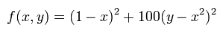
Minimum of Rosenbrock Banana Function

Slide 21
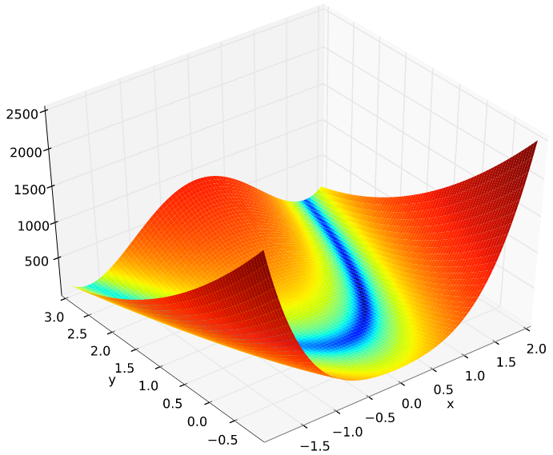
Function visualization

Slide 22

Demo steps
Compile the sample matlab project
Copy the resultant files into a new directory
Download the MATLAB compiler runtime and create a new folder
Create a small .bat file to unzip the MATLAB compiler
Create an HPC package and upload to storage with the compiler
Create a startup script and package and upload
Update the node template
Add cluster nodes and bring online
Package the demo files and upload to HPC
Run an hpcsync command and sync with the cluster nodes
Create a new parametric sweep task and execute
Check the output directory in storage
Run the postprocess script to calculate the minimum from the results

Slide 23
R-Python demo
Demo
Notes:
1 – simple Example
2 – Real world – KINECT!

Slide 24
Find out the percentage of the 100 most popular names in the US which are given to newborns

Slide 25
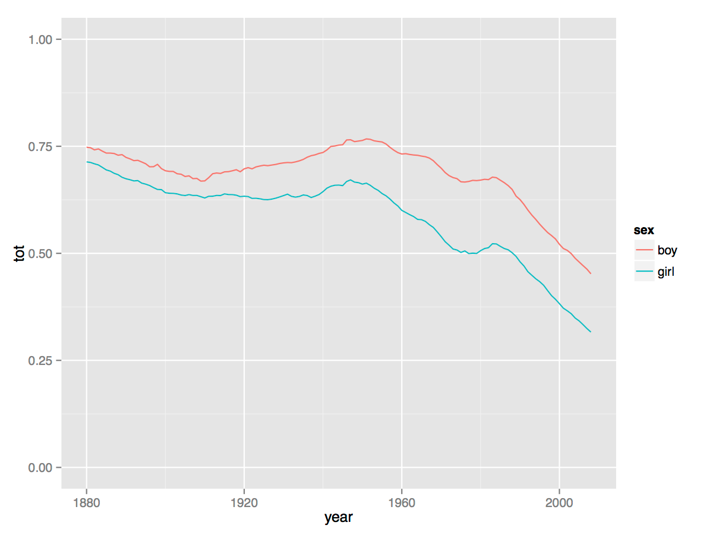
Plot visualization

Slide 26
Demo steps
Download the Azure CLI onto the head node
Get a .publishsettings file and import into the CLI
Install the Python SDK for Windows Azure
Create an HPC package of the C:\Python27 directory and upload
Install R on the head node and install plyr and ggplot2
Create an install .bat file and hpcpack
Upload R to the cluster
Create a startup script to xcopy python and install R
Add the script to a new node template
Create a package for the application files and upload to the cluster
Create a new parametric sweep job and execute
Run the local R script to create a graph from the results

Slide 27
Using HPC in the Cloud
Learning objectives – what we have learned:
Microsoft's High Performance Computing (HPC) distributed computing Server
A design pattern for scaling parameter sweep/map reduce for scientific analysis using standard tool with Windows HPC
Examples of when this is useful for research scientists

Slide 28
© 2013 Microsoft Corporation. All rights reserved. Microsoft, Windows, Windows Vista and other product names are or may be registered trademarks and/or trademarks in the U.S. and/or other countries.
The information herein is for informational purposes only and represents the current view of Microsoft Corporation as of the date of this presentation. Because Microsoft must respond to changing market conditions, it should not be interpreted to be a commitment on the part of Microsoft, and Microsoft cannot guarantee the accuracy of any information provided after the date of this presentation. MICROSOFT MAKES NO WARRANTIES, EXPRESS, IMPLIED OR STATUTORY, AS TO THE INFORMATION IN THIS PRESENTATION.

